Slide 1
Donner 3 exemples de l’application BI de l’industrie 4.0
1-
2-
3-

Slide 2

JUNE 2015
Manufacturing’s next act
Cornelius Baur and Dominik Wee
Industry 4.0 is more than just a flashy catchphrase.
A confluence of trends and technologies promises to
reshape the way things are made.
Mention “Industry 4.0” to most manufacturing executives and you will raise eyebrows.
If they’ve heard of it, they are likely confused about what it is. If they haven’t heard
of it, they’re likely to be skeptical of what they see as yet another piece of marketing
hype, an empty catchphrase. And yet a closer look at what’s behind Industry 4.0 reveals
some powerful emerging currents with strong potential to change the way factories
work. It may be too much to say that it is another industrial revolution. But call it
whatever you like; the fact is, Industry 4.0 is gathering force, and executives should
carefully monitor the coming changes and develop strategies to take advantage of
the new opportunities.
Coming to terms
Start with some definitions. We define Industry 4.0 as the next phase in the digitization
of the manufacturing sector, driven by four disruptions: the astonishing rise in data
volumes, computational power, and connectivity, especially new low-power wide-area
networks; the emergence of analytics and business-intelligence capabilities; new forms
of human-machine interaction such as touch interfaces and augmented-reality systems;
and improvements in transferring digital instructions to the physical world, such as
advanced robotics and 3-D printing. (The four trends are not the reason for the “4.0,”
however. Rather, this is the fourth major upheaval in modern manufacturing, following
the lean revolution of the 1970s, the outsourcing phenomenon of the 1990s, and the
automation that took off in the 2000s.)
Most of these digital technologies have been brewing for some time. Some are not
yet ready for application at scale. But many are now at a point where their greater
reliability and lower cost are starting to make sense for industrial applications. However,
companies are not consistently aware of the emerging technologies. We surveyed
300 manufacturing leaders in January 2015; only 48 percent of manufacturers
consider themselves ready for Industry 4.0. Seventy-eight percent of suppliers say
they are prepared.

Slide 3
2
Consider an example of each disruptive trend:
ƒ
Big data. An African gold mine found ways to capture more data from its sensors. New data
showed some unsuspected fluctuations in oxygen levels during leaching, a key process. Fixing
this increased yield by 3.7 percent, worth up to $20 million annually.
ƒ
Advanced analytics. Stronger analysis can dramatically improve product development. One
automaker uses data from its online configurator together with purchasing data to identify
options that customers are willing to pay a premium for. With this knowledge, it reduced the
options on one model to just 13,000—three orders of magnitude fewer than its competitor,
which offered 27,000,000. Development time and production costs fell dramatically; most
companies can improve gross margin by 30 percent within 24 months.
ƒ
Human-machine interfaces. Logistics company Knapp AG developed a picking technology
using augmented reality. Pickers wear a headset that presents vital information on a see-
through display, helping them locate items more quickly and precisely. And with both hands
free, they can build stronger and more efficient pallets, with fragile items safeguarded. An
integrated camera captures serial and lot ID numbers for real-time stock tracking. Error rates
are down by 40 percent, among many other benefits.
ƒ
Digital-to-physical transfer. Local Motors builds cars almost entirely through 3-D printing,
with a design crowdsourced from an online community. It can build a new model from scratch
in a year, far less than the industry average of six. Vauxhall and GM, among others, still bend a
lot of metal, but also use 3-D printing and rapid prototyping to minimize their time to market.
These changes and many others like them are sure to be far reaching, affecting every corner of
the factory and the supply chain. The pace of change, however, will likely be slower than what
we’ve seen in the consumer sector, where equipment is changed frequently. The coming of steam
power and the rise of robotics resulted in the outright replacement of 80 to 90 percent of
industrial equipment. In coming years, we don’t expect anything like that kind of capital
investment. Still, the executives surveyed estimate that 40 to 50 percent of today’s machines
will need upgrading or replacement.
Lightning in a bottle
To capture the potential, manufacturers can consider three moves. Primarily, companies can
gather more information and make better use of it. An oil-exploration company collected more
than 30,000 pieces of data from each of its drilling rigs—yet 99 percent of that data was lost due
to problems of data transmission, storage, and architecture. The tiny trickle of data it did capture
was incredibly useful for managers. But so much more can be done. The executives we surveyed
said that correcting these data inefficiencies should improve productivity by about 25 percent.

Slide 4
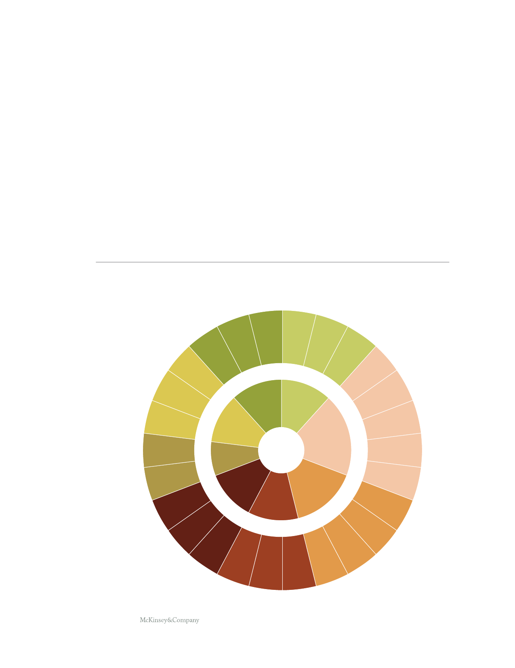
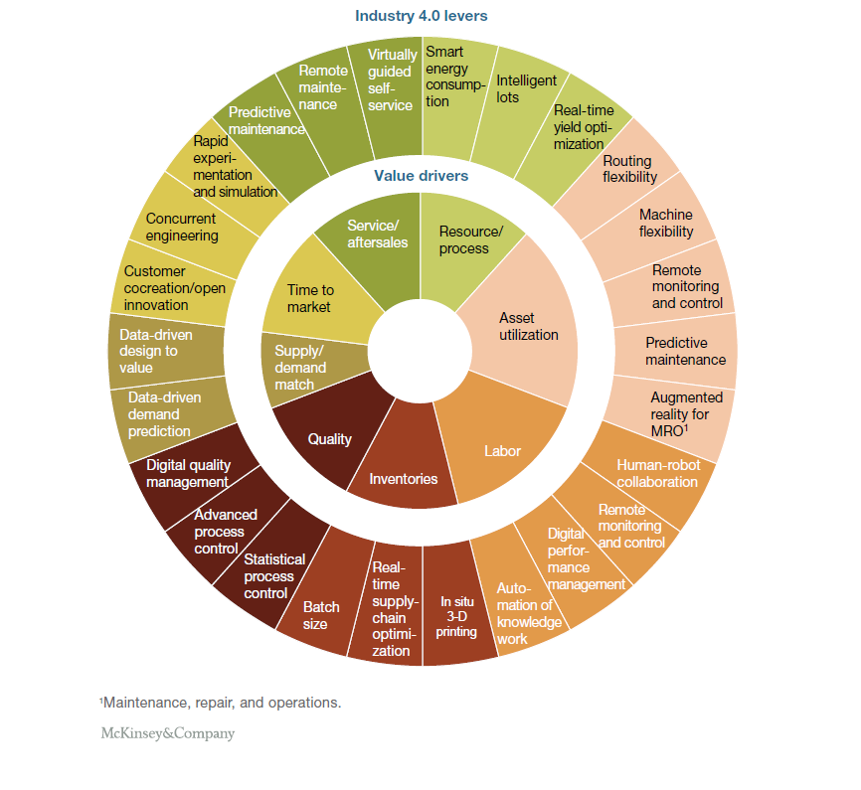
3
With production data now available for the asking, executives rightly wonder about how to begin. Which
data would be most beneficial? Which data leakages are causing the most pain? Which technologies
would deliver the biggest return on investment for a company, given its unique circumstances? To sort
through the choices, manufacturing leaders can use a “digital compass” (exhibit). The compass consists
of eight basic value drivers and 26 practical Industry 4.0 levers. Cross-functional discussions that
will help companies find the levers that are best suited to solve their particular problems.
One kind of lost value that is sure to interest manufacturers is process effectiveness. Industry
4.0 offers new tools for smarter energy consumption, greater information storage in products
Exhibit
The ‘digital compass’ helps companies ﬁnd tools to match their needs.
Smart
energy
consump- Intelligent
lots
tion
Real-time
yield opti-
mization
Routing
Value driversexibility
Remote
mainte-
nance
Virtually
guided
self-
service
Predictive
maintenance
Rapid
experi-
mentation
and simulation
Concurrent
engineering
Service/
aftersales
Resource/
process
Machine
exibility
Customer
cocreation/open
innovation
Time to
market
Remote
monitoring
and control
Data-driven
design to
value
Asset
utilization
Predictive
maintenance
Supply/
demand
match
Data-driven
demand
prediction
Augmented
reality for
MRO1
Digital quality
management
Quality
Labor
Human-robot
collaboration
Inventories
Advanced
process
control
Statistical
process
control
Batch
size
Remote
monitoring
and control
Digital
perfor-
mance
Auto- management
mation of
knowledge
work
Real-
time
supply-
chain
optimi-
zation
In situ
3-D
printing
Maintenance, repair, and operations.
1

Slide 5
4
and pallets (so-called intelligent lots), and real-time yield optimization. Swiss giant ABB used
the latter in an Australian cement kiln. A computer-based system mimics the actions of an
“ideal” operator, using real-time metrics to adjust kiln feed, fuel flow, and fan-damper position.
The company found that the new tools boosted throughput by up to 5 percent.
The bigger picture
Strategists should also take Industry 4.0 into account as they contemplate the company’s future
directions—the second way to capture the potential. The traditional manufacturing business
model is changing, and new models are emerging; incumbents must be quick to recognize and
react to these new competitive challenges. More specifically, executives must consider the
following options—and watch for others that may be deploying them. Eighty-four percent of
the manufacturing suppliers we surveyed expect new competitors to enter the market soon.
ƒ
“Platforms,” in which products, services, and information can be exchanged via predefined streams.
Think open-source software applied to the manufacturing context. For example, a company
might provide technology to connect multiple parties and coordinate their interactions. SLM
Solutions, a 3-D-printer manufacturer, and Atos, an IT services company, are currently running
a pilot project to develop such a marketplace. Customers can submit their orders to a virtual broker
platform run by Atos. Orders are then allocated to SLM’s decentralized network of production sites,
and subsequently produced and shipped to the customer. Some companies are also trying to build
an “ecosystem” of their own, as Nvidia has in its graphics-processor business. It provides software
developers with resources, and offers start-ups help to build companies around Nvidia technologies.
ƒ
Pay-by-use and subscription-based services, turning machinery from capex to opex for
manufacturers. Rolls-Royce pioneered this approach in its jet-engine business; other
manufacturers have followed suit.
ƒ
Businesses that license intellectual property. Today, many manufacturing companies have
deep expertise in their products and processes, but lack the expertise to generate value
from their data. SAP offers consulting services that build on its software. Qualcomm makes
more than half of its profits from intellectual-property royalties. Manufacturers might offer
consulting services or other businesses that monetize the value of their expertise.
ƒ
Businesses that monetize data. The SCiO, a Kickstarter project, is a low-cost, pocket-sized
spectrometer that uses near-infrared technology to assess the composition of materials. It is
expected to cost $250, whereas traditional machines cost upward of $10,000. Every time a SCiO
is used, it contributes to a large database of scanned materials, helping to make the machine
more accurate. To be sure, it is a consumer product, and not yet ready for industrial use. But
industrial models are on the way. Kaggle, a distributed network of about 270,000 data scientists,
has already helped more than 20 Fortune 500 companies solve their toughest data problems.

Slide 6

5
To get the most out of Industry 4.0 technologies, and to get past square one with a digital
business model, companies will have to take a third step: prepare for a digital transformation.
Manufacturers should begin today to join the hunt for the best digital talent, and think about
how to structure their digital organization. Data management and cybersecurity will be
critical problems to solve. Many companies will find that a “two speed” data architecture can
help them deploy new technologies at the speed required, while also preserving mission-
critical applications.
Cornelius Baur is a director in McKinsey’s Munich office, where Dominik Wee is a partner.
Copyright © 2015 McKinsey and Company. All rights reserved.

Slide 7
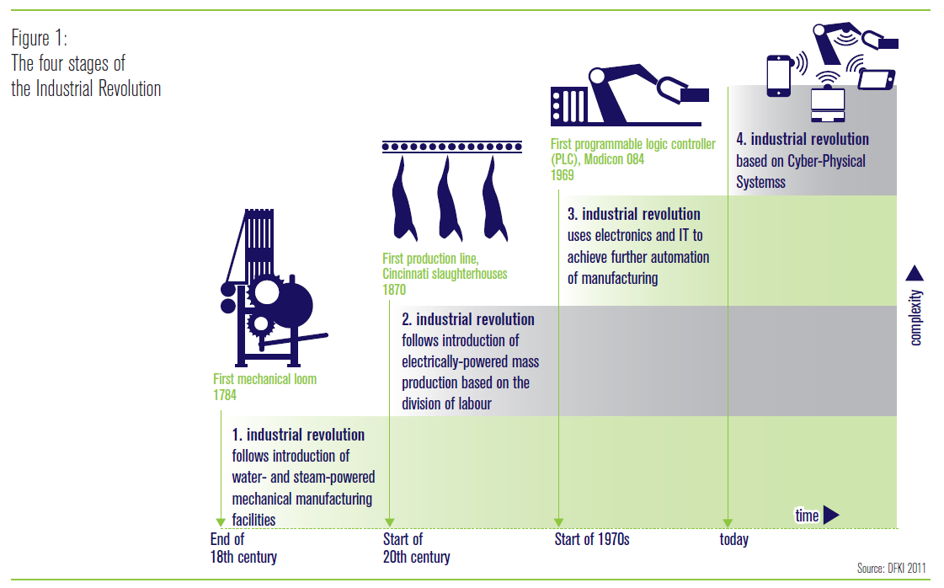
Industrie 4.0 -importance

Slide 8
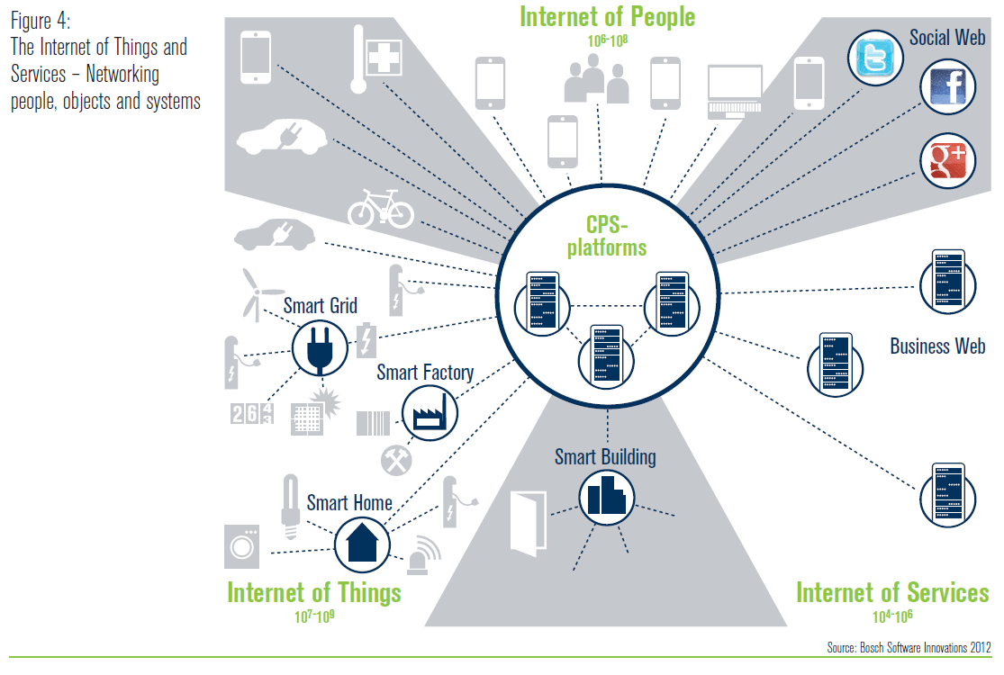
Truly integrated end-to-end

Slide 9
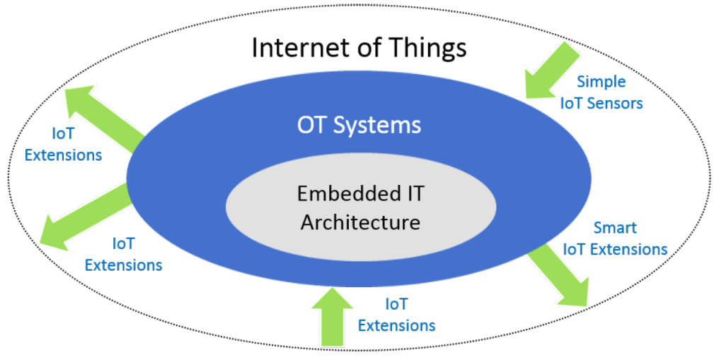
Industry 4.0
Key questions | How to best position technologies? How to choose right technologies? What are the potential technologies to look at? How to redesign the organization to work in a remote fashion? (a) Processes, (b) Organizational structure & (c) Technologies
Inventories
Real-time supply chain optimization
Resource/process
Smart energy consumption
Real-time yield optimization
Labour
Remote monitoring and control
Digital performance management
Automation of knowledge work
Asset utilization
Machine flexibility
Remote monitoring and control
Predictive maintenance
Augmented reality for MRO
Quality
Advanced process control
Statictical process control
IT/OT Security
Cyber-Physical System Security

Slide 10
Industrie 4.0
 | About (this topic)
 | 4th Industrial Revolution Horizontal and vertical system integration (across departments and between partners in the value chain); The Internet of Things; Cybersecurity; End-to-End Engeneering; SmartFactory; Cyber-Physical Systems. Disruptive trends are: Big data; Advanced Analytics; Human-machine interface; Digital-to-physical transfer (e.g. 3D printing)

Slide 11
Resource/Process
 | About (this topic)
 | Industrie 4.0 will need to investigate and implement ways of reducing the resources consumed during industrial manufacturing processes as a whole and by the machinery and equipment used during production. (Industry 4.0 Working Group, 2013, p.62) Both in terms of Productivity (preventing unstable processes that result in quality issues) and Availability such as resources being available when needed and managing their inventory. | (
Smart energy consumption | Smart Grid technologies (e.g., consuming in non-peak times and not consuming in idle time).
Real-time yield optimization | Small variances in raw material specifications and process yield can have a significant impact on product quality, regulatory compliance and profitability. Monitor and manage the complex interdependence of material characteristics, equipment performance, process parameters and other variables that impact product quality and consistency.

Slide 12
Asset utilization
 | About (this topic)
Machine flexibility | Adapt the production to current demand (no need to reconfigure the assembly line or production system to obtain customized products). Decoupled, fully flexible and highly integrated manufacturing systems (see Hewlett-Packard 2013 in Industrie 4.0 Working Group) End-to-end system engineering...
Remote monitoring and control | In Industrie 4.0, technicians will no longer manually connect to the machine they are servicing. Manufacturing systems will operate as “social machines” – in networks that are similar to social networks – and will automatically connect to cloud-based telepresence platforms in order to search for the appropriate experts to deal with the situation in question. The experts will then be able to use integrated knowledge platforms, videoconferencing tools and enhanced engineering methods to perform traditional remote maintenance services more efficiently via mobile devices. Moreover, machines will continuously enhance and expand their own capabilities as the situation requires by automatically updating or loading the relevant functions and data via standardized, secure communication links with the telepresence platforms. By shifting complex computational tasks (e.g. simulations and projections) away from the machines to the portals it will be possible to employ huge amounts of processing power to ensure that they are performed in the shortest possible time, thus delivering additional productivity gains. (Industrie 4.0 Working Group, 2013, p.65)
Predictive maintenance Augmented reality for MRO (Maintenance Repair Operations) | As the cost of sensors and communications comes down, and as storage capability and processing speed increase (for example, Hadoop), enormous troves of operational technology (OT) data are being collected and stored, but remain unused or underused. OT is markedly different from IT — in application, architectural characteristics and need for different governance. Data scientists versed in OT are consequently rare. Combining IT and OT holds transformational possibilities in analytics for asset-intensive industries, but will require new approaches to data integration and management, and an evolution of infrastructure and skills for data integration, management, and analytics. (G00264728)

Slide 13
Labour
 | Work organization and design: In smart factories, the role of employees will change significantly. Increasingly real-time oriented control will transform work content, work processes and the working environment. Implementation of a socio-technical approach to work organization will offer workers the opportunity to enjoy greater responsibility and enhance their personal development. For this to be possible, it will be necessary to deploy participative work design and lifelong learning measures and to launch model reference projects. (Industrie 4.0 Working Group, 2013)
Remote monitoring and control | 1. Machines will share/supplement decision-taking, coordination, control and support. 2. It will be necessary to organize and coordinate the interactions between virtual and real machines, plant control systems and production management systems. (Industrie 4.0 Working Group, 2013, p.55)
Digital performance management | Maintaining and improving the productivity of the workforce (Industrie 4.0 Working Group, 2013, p.23).
Automation of knowledge work | With talent constraints named by CEOs as the primary obstacle for growth, businesses that distribute work among human beings, software and robots will gain an advantage. The differentiating value of human beings will live in applying creativity, critical thinking, empathy and innovation to new outcomes. Human beings + technology will be the "killer combo" through the next decade, requiring CIOs and HR executives to be the voice of holistic thinking. (G00247128)

Slide 14
Inventory (resource efficiency & availability)
 | About (this topic)
Real-time supply chain optimization | Companies are unsure what to do with the forecast accuracy measurement results, and therefore do not know what lag time to use for the calculation. Supply chain planning leaders are reluctant to measure demand forecast accuracy across longer planning horizons (longer lag times) because the SKU level results deteriorate with forecasts further out in the future. Publicizing forecast error, especially when it is not good, may cause some stakeholders to shy away from adopting formal demand forecasting in a cross-functional planning process. (G00279668) Companies often fail in their attempts to buy their way into end-to-end inventory optimization capabilities by solely purchasing an advanced and expensive multi echelon inventory optimization technology solution. (G00273529)

Slide 15
Quality
 | About (this topic)
Advanced process control & Statistical process control | Operational technologies (OTs) are often managed outside of corporate IT departments. That situation can lead to challenges, including system access, physical connectivity and governance issues. OT vendors typically differ from IT vendors in their approach to architecture and security. Arriving at a mutually beneficial compromise is a necessary process for CIOs and their organizations. Many organizations lack formal OT software management, and do not view the technology of OT systems the same way they view IT. This lack of management makes it difficult for CIOs to determine the financial reward or strategic benefits of integration. (G00291878)

